Slide 1
Using Spring 4 and AngularJS for REST-based web applications development
Vladimir Sonkin
Java & Web expert
Luxoft Training

Slide 2
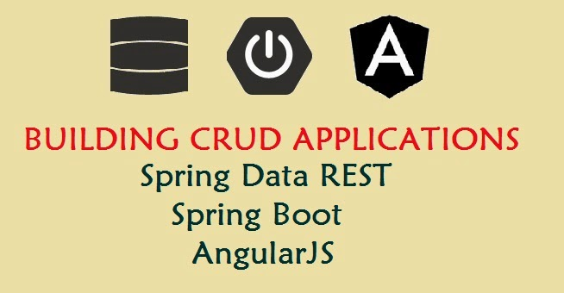
Technologies used
REST
Spring Boot
Spring Data
AngularJS

Slide 3
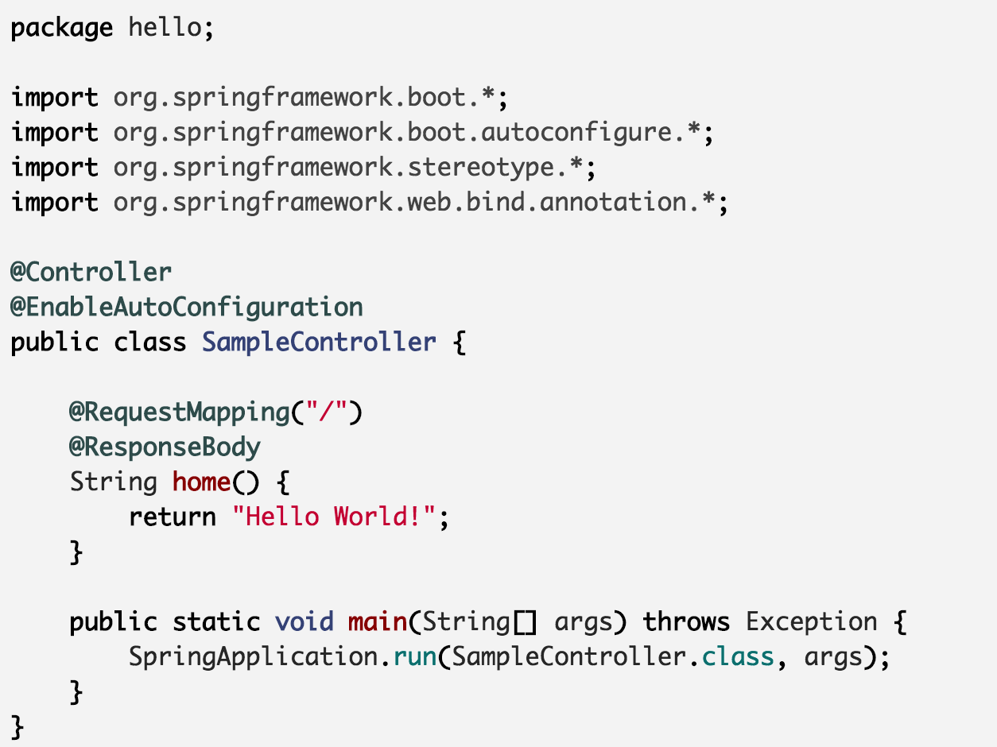
Spring Boot
mvn spring-boot:run

Slide 4
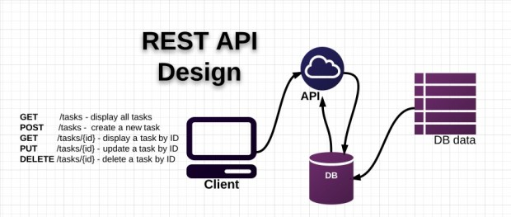
REST API

Slide 5
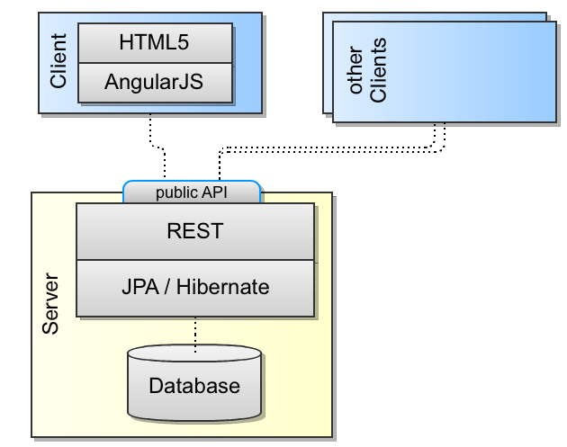
REST architecture

Slide 6
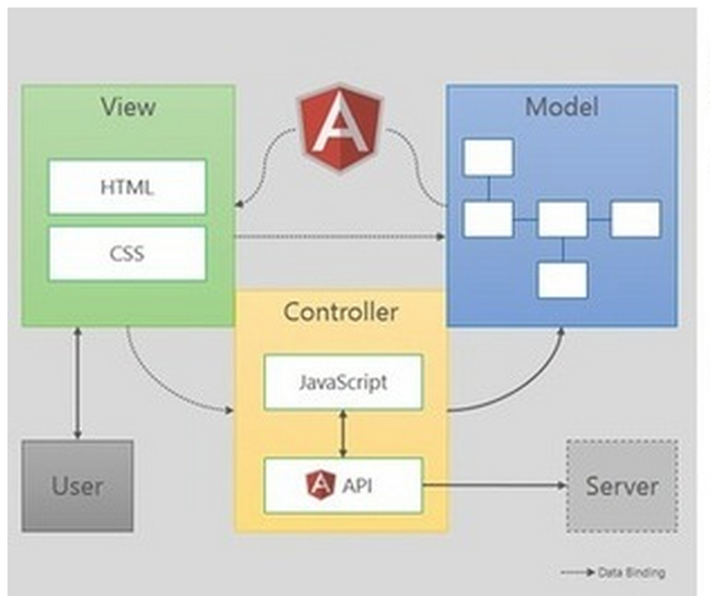
What Angular provides
Architecture/organization patterns out of the box (MVC/SPA/DI)
View templating using plain-old HTML (no new templating language to learn) for creating dynamic views
Allows to extend HTML vocabulary to create new UI widgets/components
Avoids scattered DOM manipulation spaghetti code
Inherent support for testing of the application
Provides modularity, loose coupling and reusability
Parallel development and comprehensible code due to virtue of MVC
Notes:
http://www.codeproject.com/Articles/869712/AngularJS

Slide 7
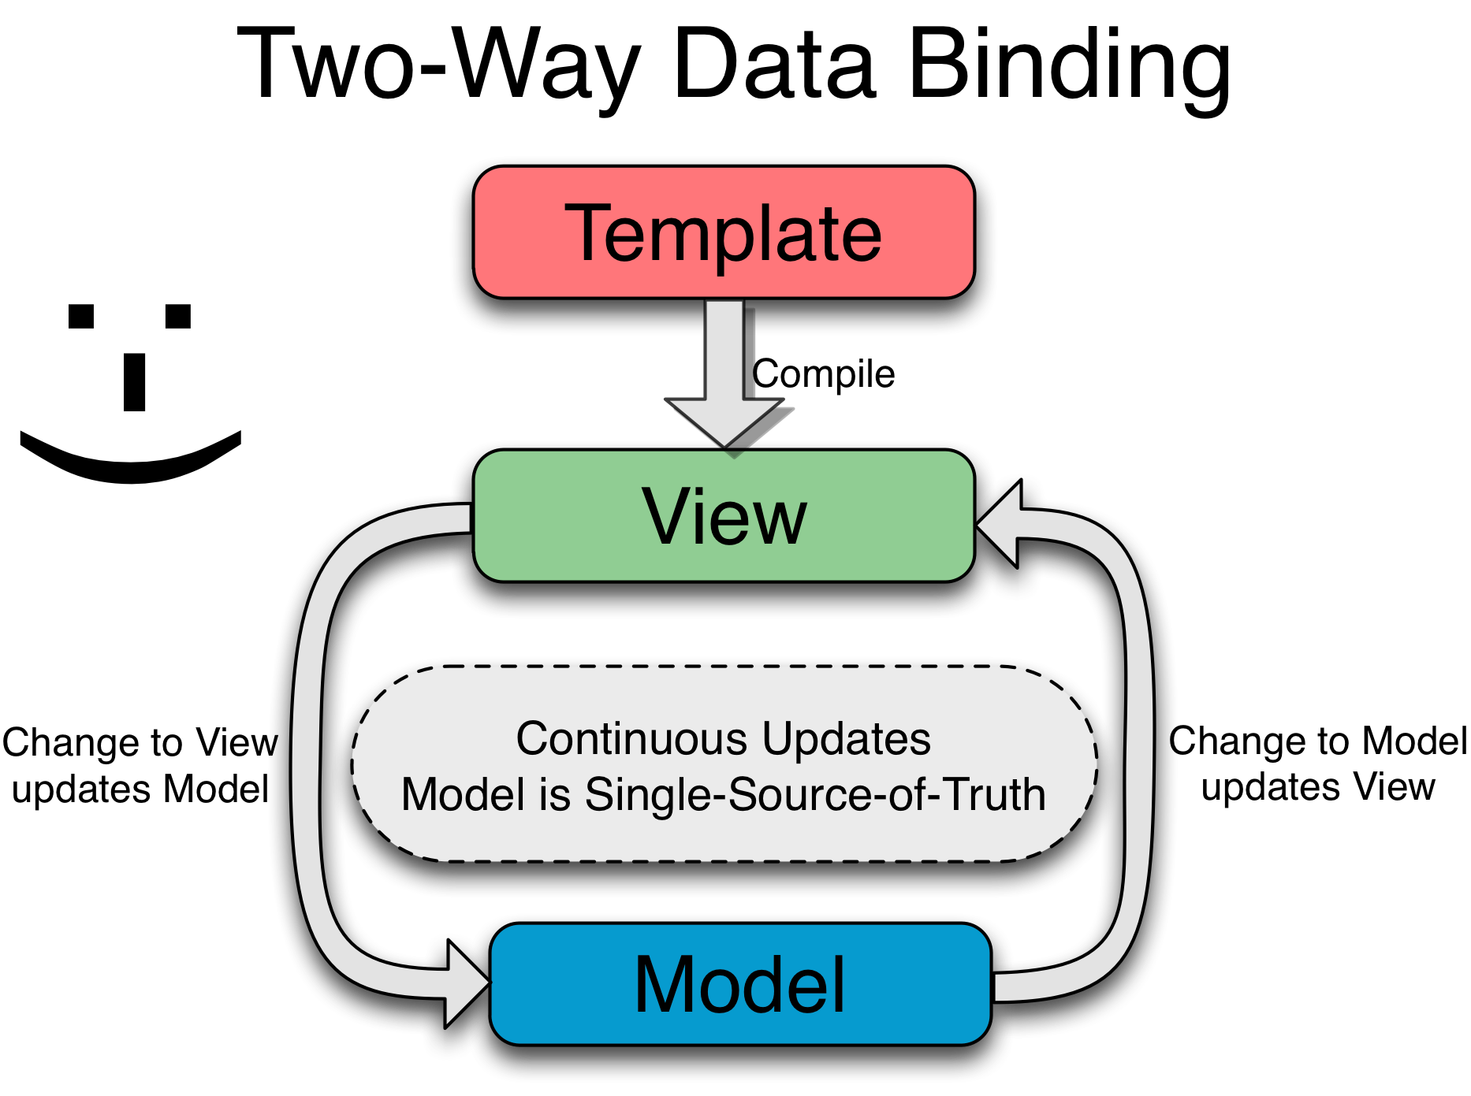
AngularJS' two-way data-binding handles the synchronization between the DOM and the model, and vice versa

Slide 8
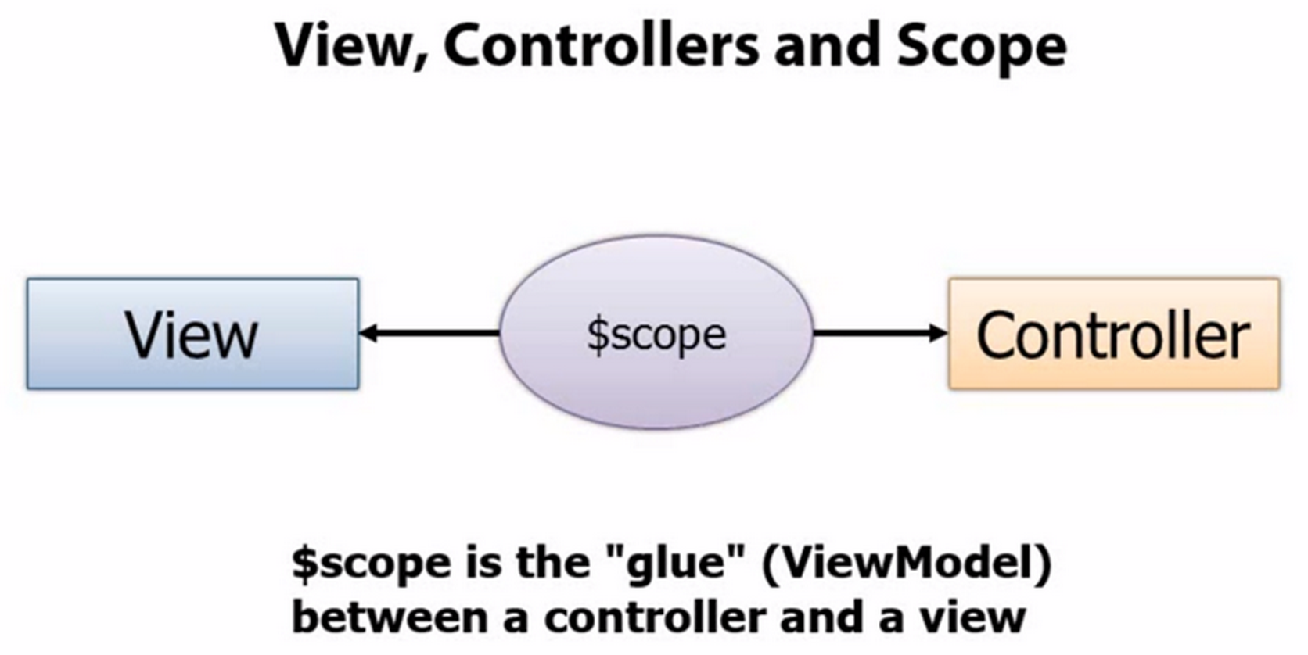

Slide 9
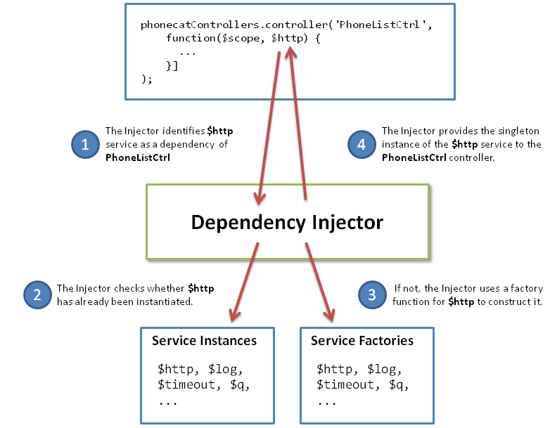

Slide 10
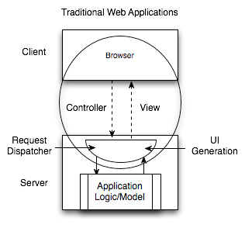
Why use a JS MVC framework
Poor distribution of processing – With a large number of clients, doing all the processing on the server is inefficient.
High user response latency
Difficult programming model
Increased vector of attack
Heavy state management on the servers
Offline Difficulties
Reduced opportunity for interoperability
Notes:
Poor distribution of processing – With a large number of clients, doing all the processing on the server is inefficient.
High user response latency – Traditional web applications are not responsive enough. High quality user interaction is very sensitive to latency, and very fast response is essential.
Difficult programming model – Programming a user interface across client/server is simply difficult. When every interaction with a user must involves a request/response, user interface design with this model is complicated and error prone. The vast number of web frameworks for simplifying web development testifies to this inherent difficulty. Some have mitigated this difficulty to some degree.
Increased vector of attack – Unorganized mingling of user interface code with business code can increase security risks. If access rules are distributed across user interface code, as user interface code grows and evolves, new vectors of attack emerge. With mixed code, new user interface features can easily create new security holes.
Heavy state management on the servers – When client user interface state information is maintained by the server, this requires a significant increase in resource utilization as server side sessions must be maintained with potentially large object structures within them. Usually these resources can’t be released until a session times out, which is often 30 minutes after a user actually leaves the web site. This can reduce performance and scalability.
Offline Difficulties – Adding offline capabilities to a web application can be a tremendous project when user interface code is predominantly on the server. The user interface code must be ported to run on the client in offline situations.
Reduced opportunity for interoperability – When client/server communication is composed of transferring internal parts of the user interface to the browser, it can be very difficult to understand this communication and utilize it for other applications.

Slide 11
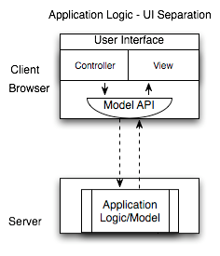
Why use a JS MVC framework
JSMVC Web Applications
Scalability - The more clients that use an application, the more client machines that are available, whereas the server processing capabilities remain constant
Immediate user response
Organized programming model
Client side state management
Offline applications
Notes:
Scalability – It is quite easy to observe the significant scalability advantage of client side processing. The more clients that use an application, the more client machines that are available, whereas the server processing capabilities remain constant (until you buy more servers).
Immediate user response – Client side code can immediately react to user input, rather than waiting for network transfers.
Organized programming model – The user interface is properly segmented from application business logic. Such a model provides a cleaner approach to security. When all requests go through user interface code, data can flow through various interfaces before security checks take place. This can make security analysis more complicated, with complex flows to analyze. On the other hand, with a clean web service interface, there is well-defined gateway for security to work on and security analysis is more straightforward, holes can be quickly found and corrected.
Client side state management – Maintaining transient session state information on the client reduces the memory load on the server. This also allows clients to leverage more RESTful interaction which can further improve scalability and caching opportunities.
Offline applications – If much of the code for an application is already built to run on the client, creating an offline version of the application will almost certainly be easier.
Interoperability – By using structured data with minimal APIs for interaction, it is much easier to connect additional consumers and producers to interact with existing systems.

Slide 12
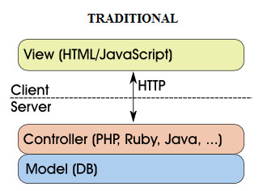
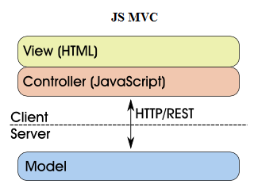
Client/server architecture
for modern web applications

Slide 13
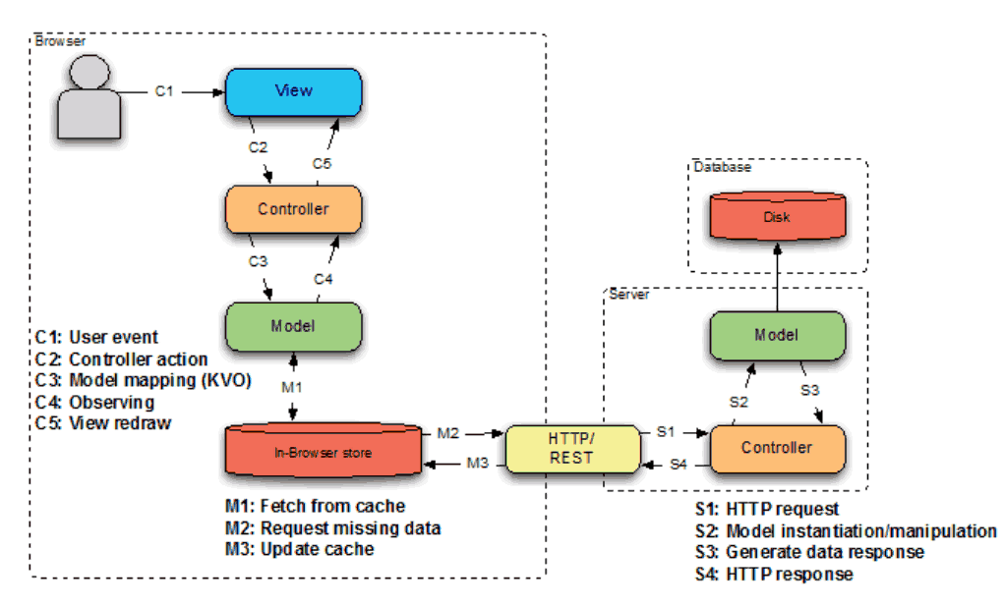
Data Flow for modern web development

Slide 14
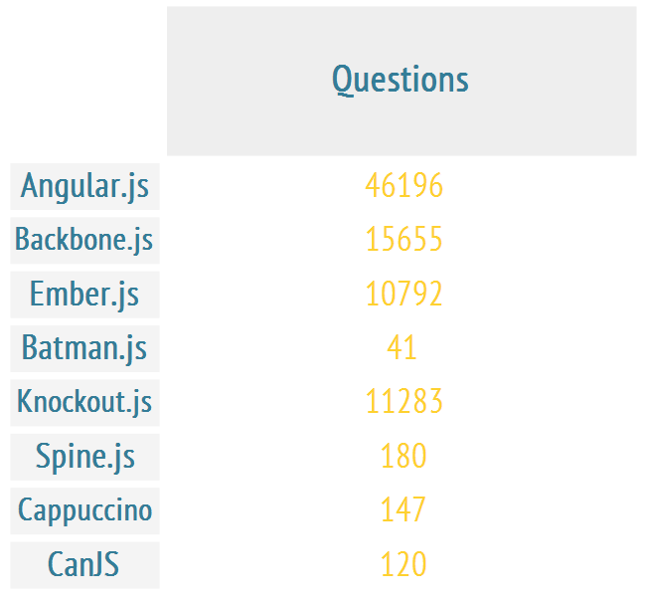
AngularJS interest

Slide 15
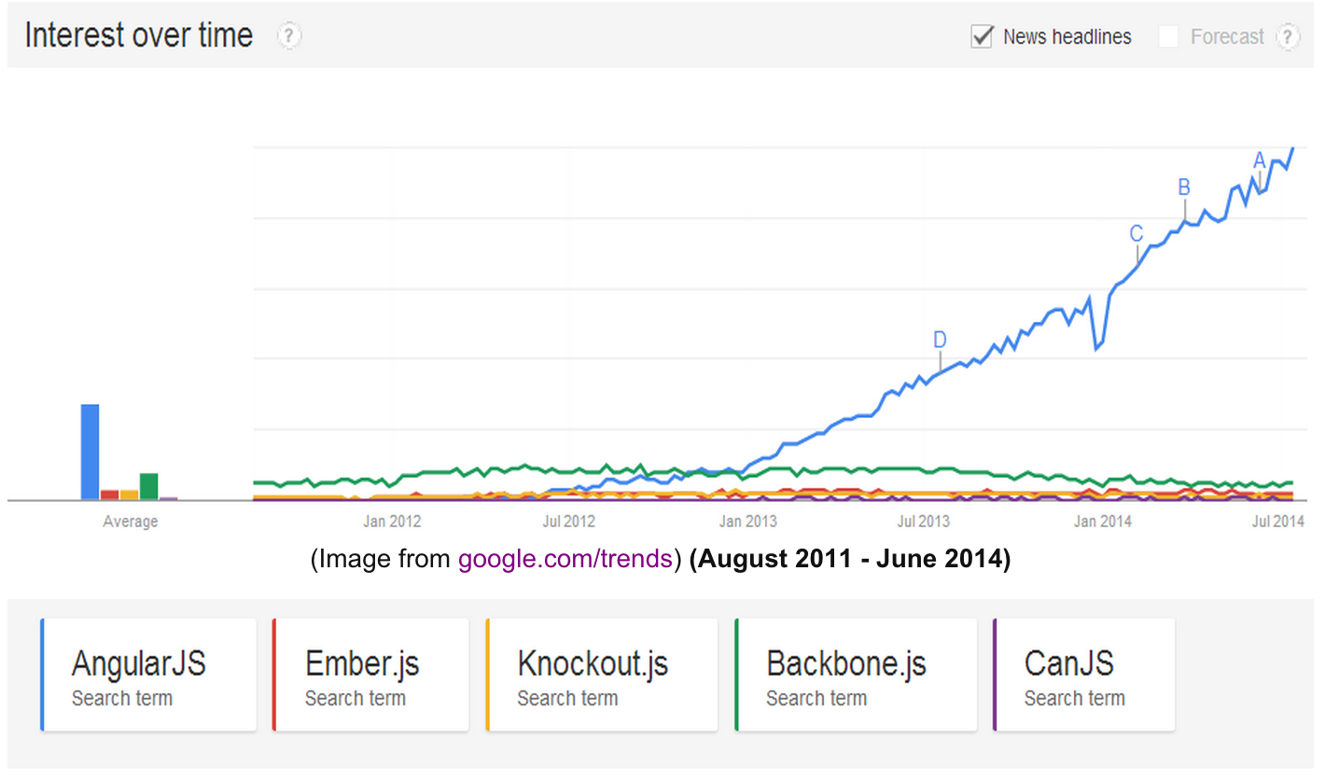
AngularJS interest

Slide 16
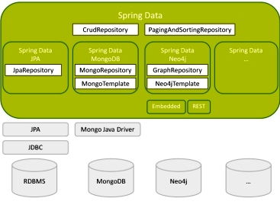

Slide 17
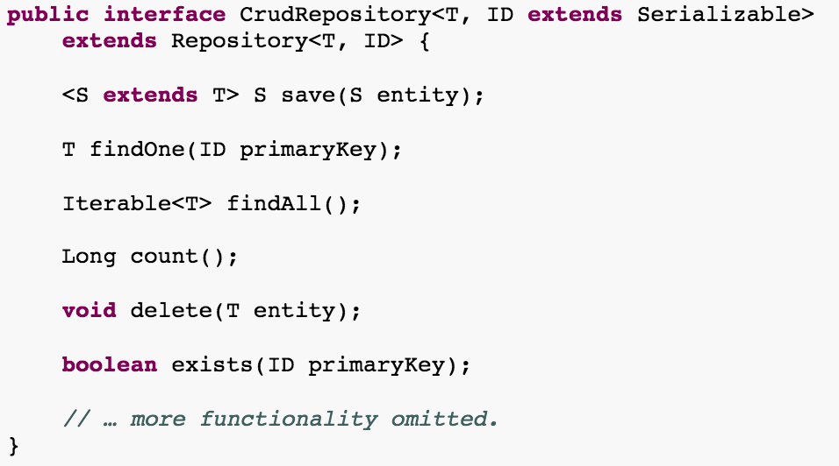
Spring Data

Slide 18
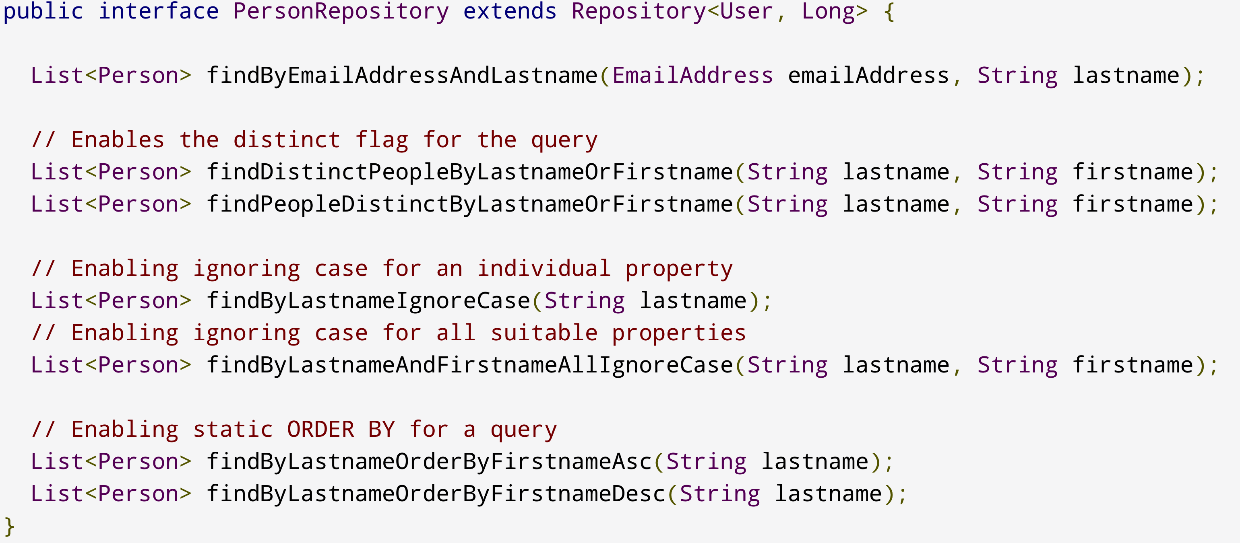
Spring Data

Slide 19
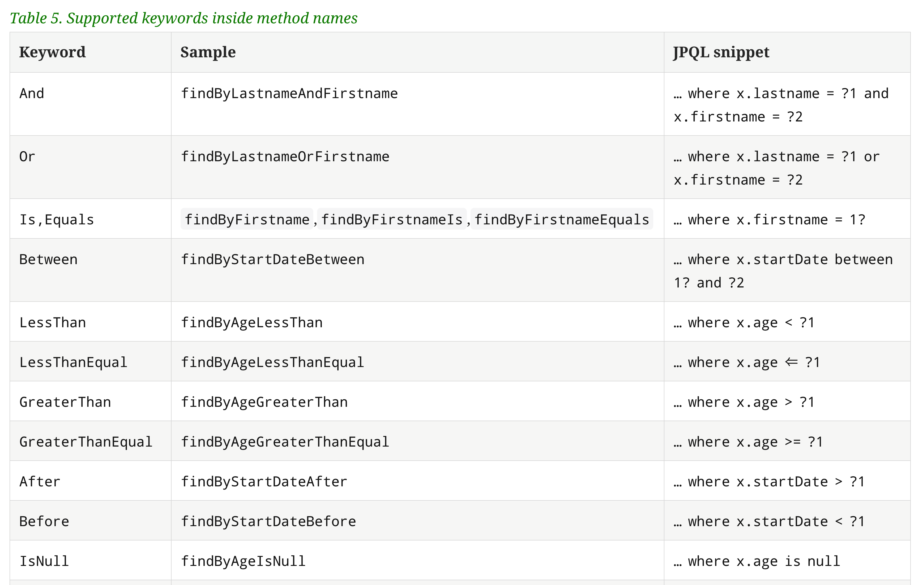
Spring JPA Repositories
Notes:
http://docs.spring.io/spring-data/jpa/docs/1.4.3.RELEASE/reference/html/jpa.repositories.html

Slide 20
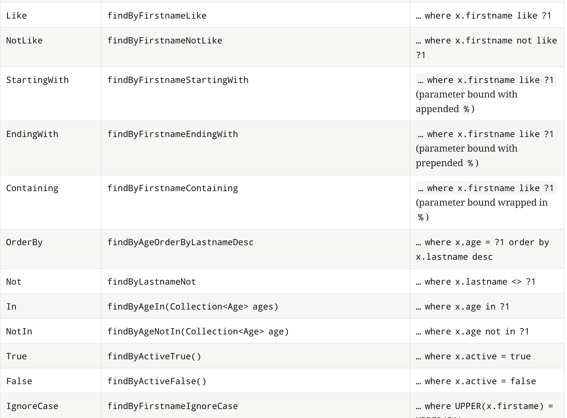

Slide 21
LINKS
http://vladson.ucoz.com/REST/
vsonkin@luxoft.com
Vladimir Sonkin

